Slide 1
Comparison of Open Source Serverless platforms
AKSHAT HARDIKBHAI SHAH - ashah004
RUTANSH MANISHKUMAR SUTHAR - rsuth004

Slide 2
Goals
Evaluating OpenFaas and KNative under Serverless ML Workload
Presentation outline
Describe Workload
Overview and Setup of OpenFaaS & KNative
Performance Comparisions and Results
Important Links

Slide 3
Workload Setup

Slide 4
Workload setup
Input / Output : A Simple Image is the input, and it returns JSON response with top 5 predictions and confidence scores.
Type : Python Based Serverless Function Running with Flask.
Goal : Image classification using a pre-trained MobileNetV2 model from TensorFlow.
Steps
Image Pre Processing
Image Classification
Input Output Handling
Error Handling
Uses Docker, Python, TensorFlow, MobileNetV2 (Pretrained Weights), Flask, JSON

Slide 5

Overview of openfaas

Slide 6
Openfaas
The Community Edition is Open Source
Lightweight and Easy to Deploy
Supports Multiple Orchestrators
Because it is the Community Edition, it:
Lacks Features like Scale to Zero.
Limited number of functions, replicas (autoscaling) and metrics.

Slide 7
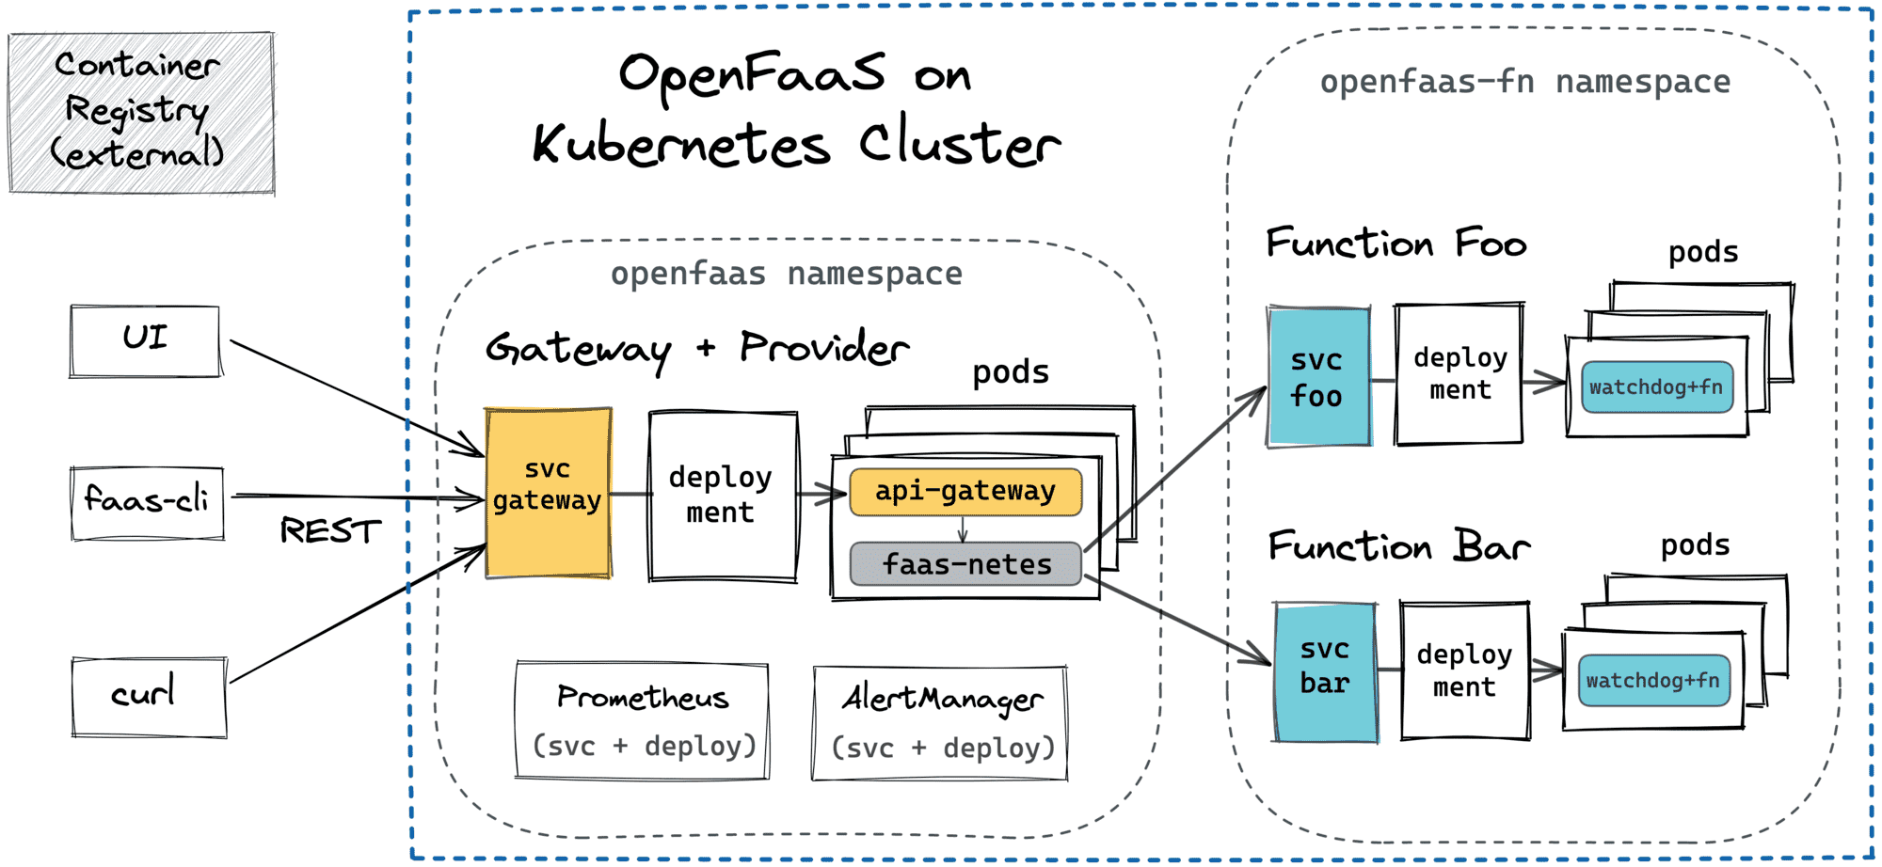
Openfaas

Slide 8
Openfaas setup
Infrastructure:
CloudLab Environment: 3 Nodes (1 Control Plane and 2 Worker).
Kubernetes Cluster: Setup using kubeadm and CRI-O container runtime.
OpenFaas Installation:
Installed OpenFaaS using Arkade.
Arkade also installed Grafana and Prometheus.
Docker
ML Workload Deployment
WRK Benchmarking

Slide 9

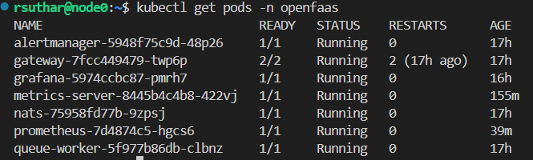
Openfaas
OpenFaaS Orchestrates the functions in the openfaas-fn namespace. It uses its own autoscaler and that will create another pod in this namespace per replica. But the community version autoscaler limits to 5 replicas that is also based on the requests per second.
It has its own openfaas namespace to host all the pods it need to function as is shown.
They are all created and linked automatically when installing openfaas with the specific flags. We just need to expose the required services.

Slide 10

Overview of Knative

Slide 11
Features of Knative
Autoscaling – Automatically scales workloads up/down, including scale-to-zero.
Traffic Management – Supports traffic splitting, blue-green, and canary deployments.
Event-driven Architecture – Seamless event production, routing, and consumption.
Pluggable Networking – Works with Istio, Contour, Kourier, etc.
Portability – Runs on any Kubernetes cluster, cloud or on-premises.
Developer-friendly – Simplifies deployment with minimal configuration.
Flexible Observability – Supports logging, monitoring, and tracing tools.

Slide 12
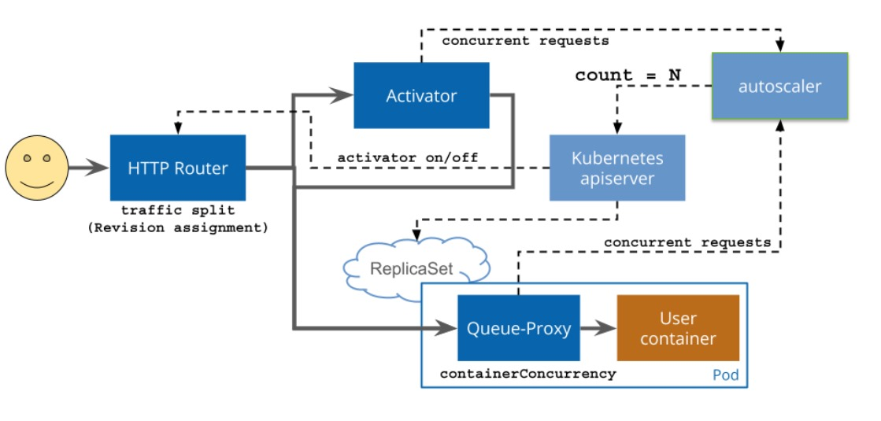
Knative

Slide 13
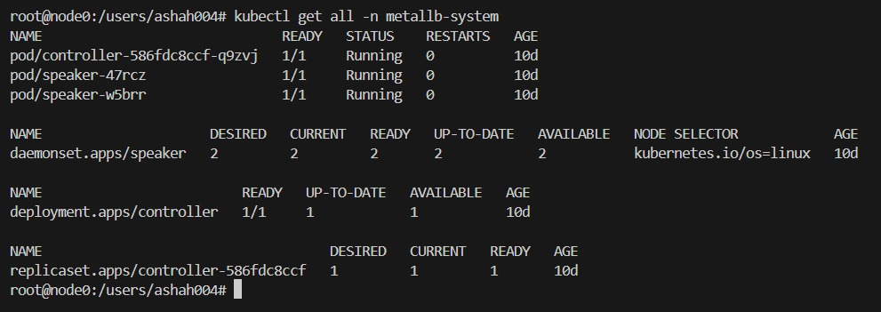
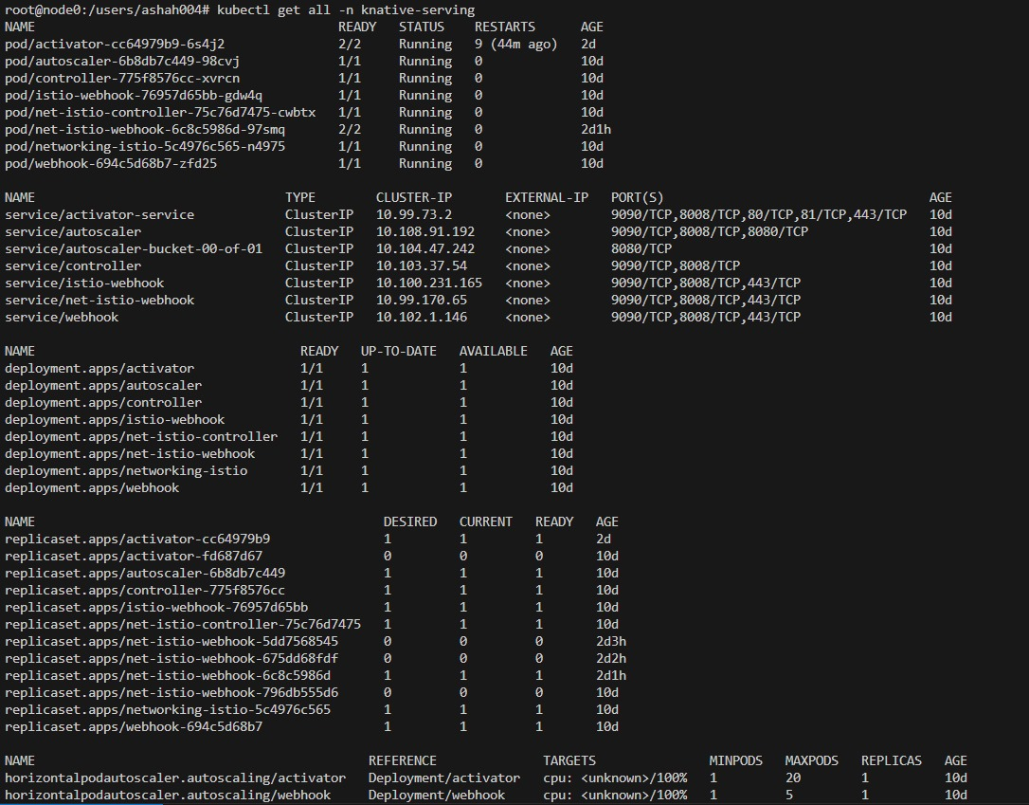
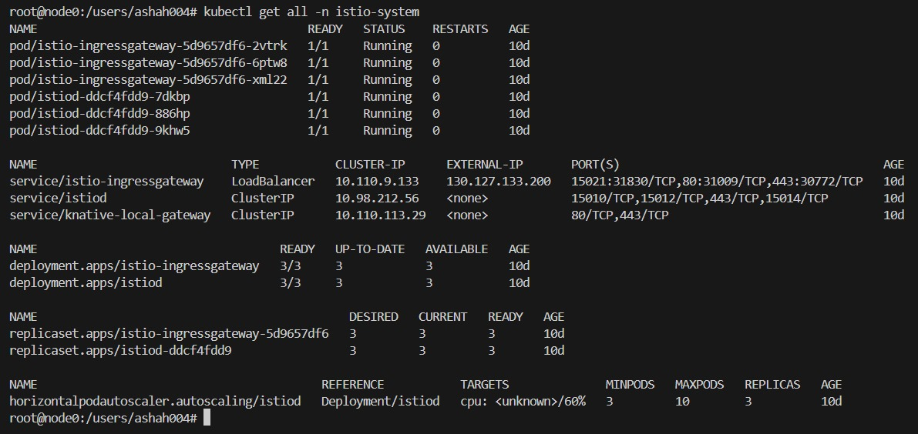

Slide 14
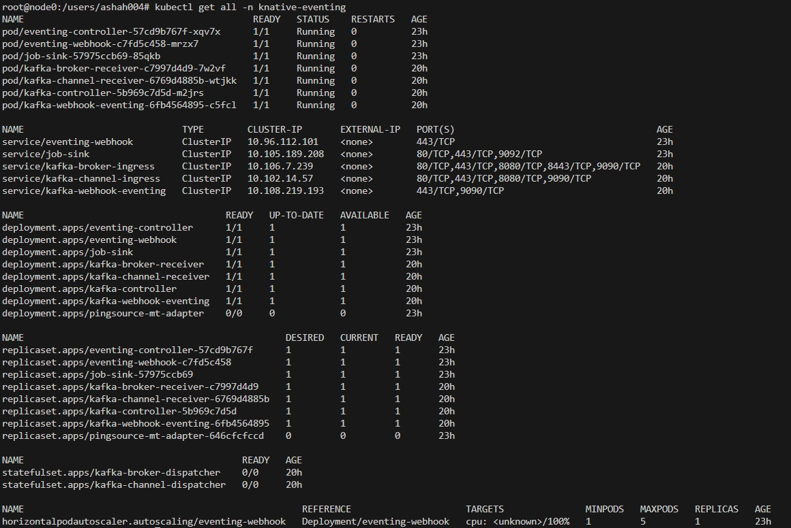
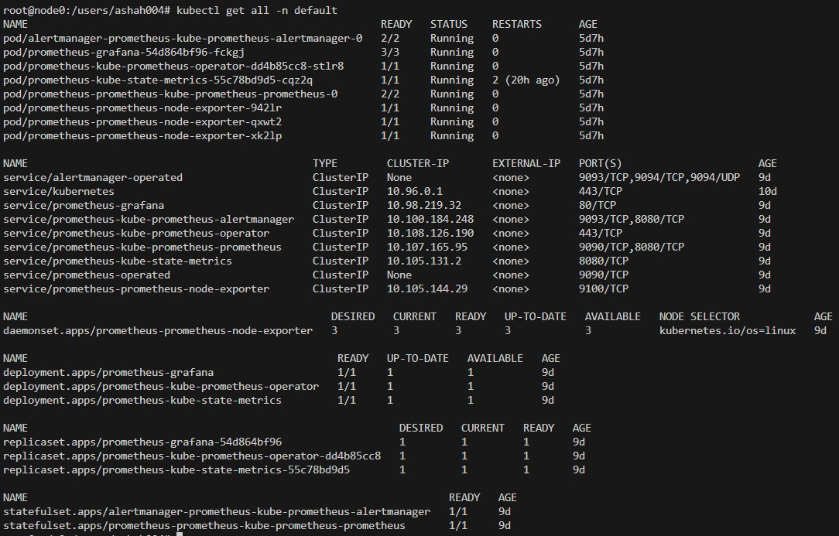
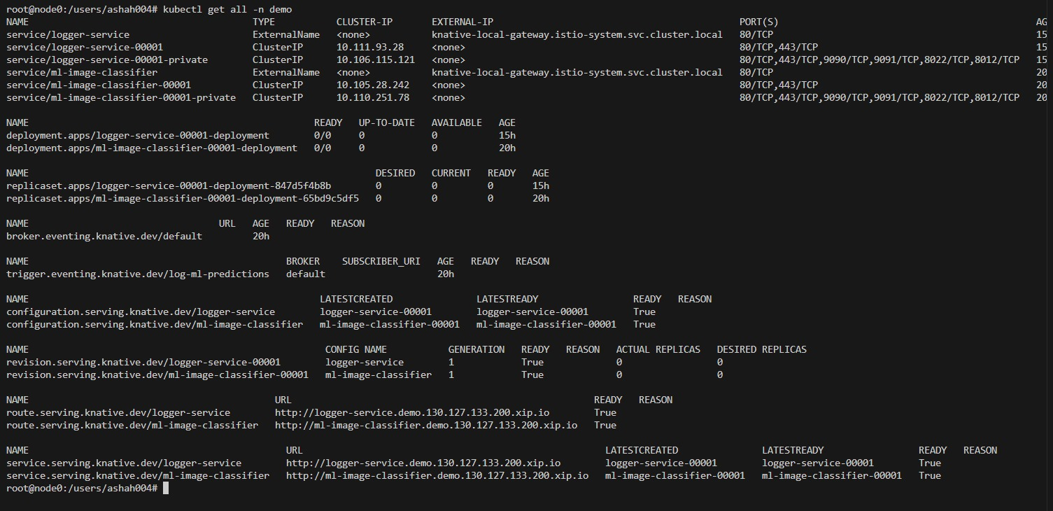

Slide 15
knative setup
Infrastructure:
CloudLab Environment: 3 Nodes (1 Control Plane and 2 Worker).
Kubernetes Cluster: Setup using kubeadm and CRI-O container runtime.
MetalLB Load Balancer:
Deployed MetalLB to manage external traffic routing and assign IPs for services exposed to the outside world.
Istio Service Mesh
Configured Istio for advanced traffic management, security, and observability between microservices.

Slide 16
Knative Setup
Set up Knative for serverless deployment of the ML model, automating scaling, routing, and networking management.
ML Model Deployment on Knative
Deployed the machine learning model on Knative, allowing automatic scaling and efficient resource management.
Prometheus and Grafana Setup
Implemented Prometheus for metrics collection and Grafana for visualizing system health and performance.
WRK Benchmarking
Used WRK to benchmark the deployed ML model, testing performance under load and ensuring it meets required throughput and response times.

Slide 17
Demo

Slide 18
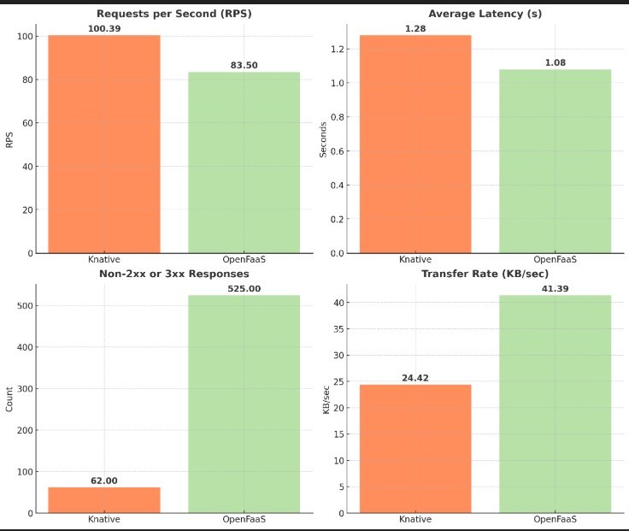
Metrics
KNative outperforms OpenFaaS in RPS, handling ~20% more requests per second (100.39 RPS vs. 83.50 RPS).
KNative (1.28s) has a slightly higher latency than OpenFaaS (1.08s).
KNative had only 62 failed requests, while OpenFaaS had 525 in total of 6000 requests.
OpenFaaS had a higher transfer rate (41.39 KB/sec) compared to KNative (24.42 KB/sec).

Slide 19
Important links
Team GitHub Repo : https://github.com/RutanshS/ml-serverless-evaluation
Google Drive : https://drive.google.com/drive/folders/1rPVVXa27XYXUZ-X5kv1xAo0S2u8n-WZ8?usp=drive_link
Kubernetes Setup: https://devopscube.com/setup-kubernetes-cluster-kubeadm/
OpenFaaS Documentation : https://docs.openfaas.com/
KNative Documentation : https://knative.dev/docs/

Slide 20
Thank you
Happy To Answer Questions

